Slide 1
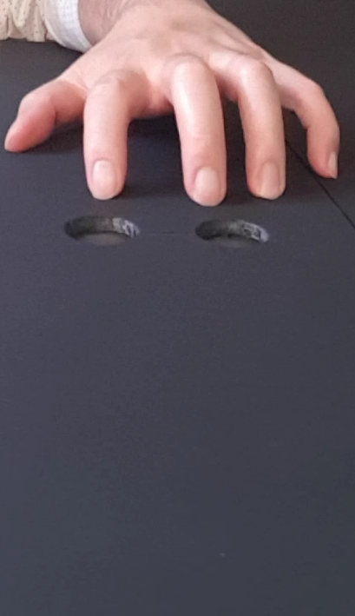
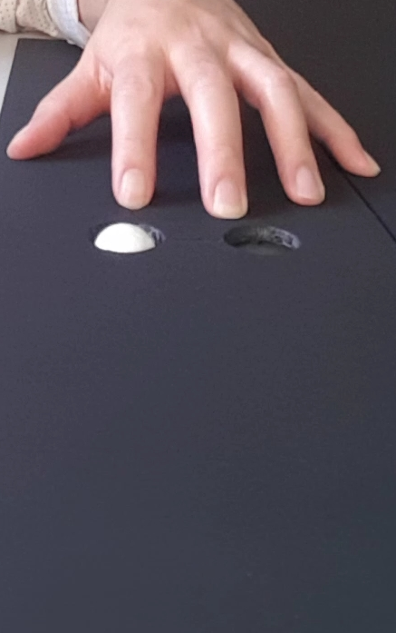
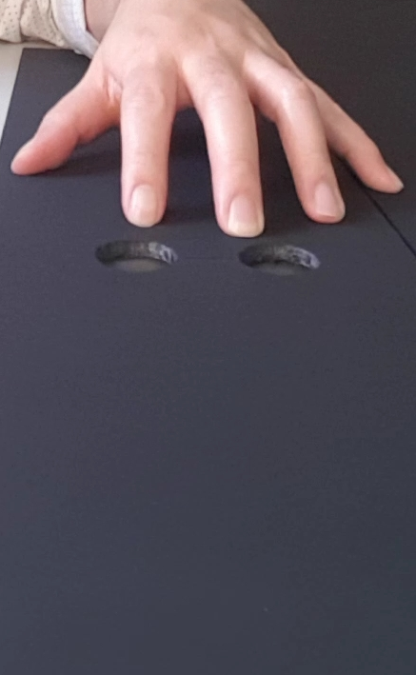
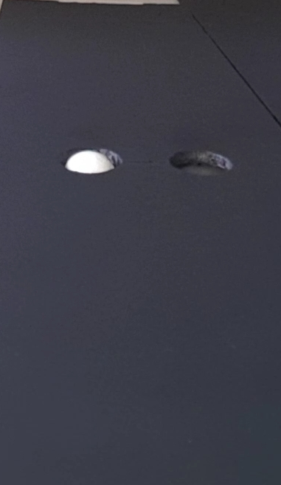
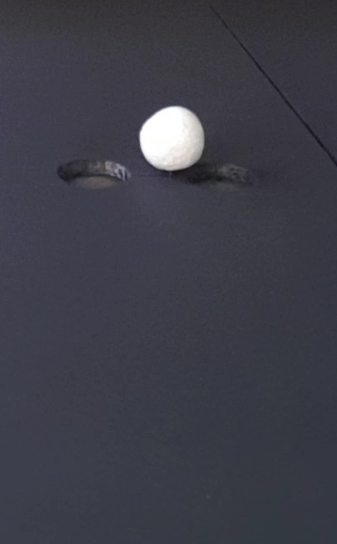
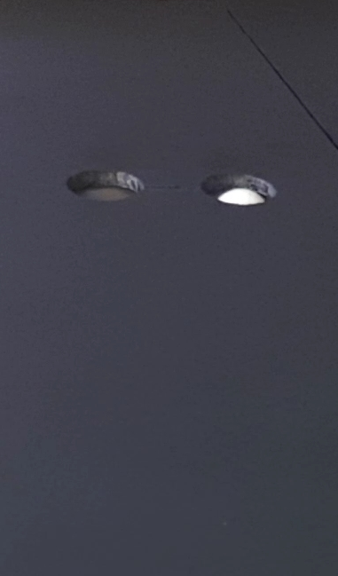
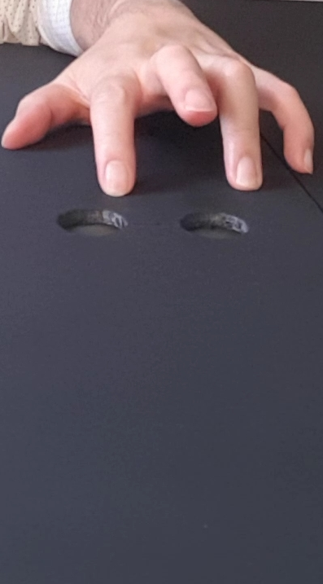
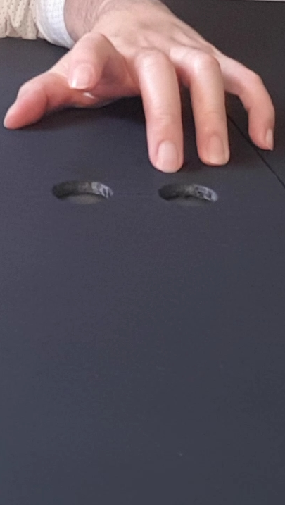
1 = Where do YOU think the ball is located?
If at index finger location, lift index finger.
If at middle finger location, lift middle finger.
2 = Where does HE think the ball is located?
If at index finger location, lift index finger.
If at middle finger location, lift middle finger.
Agent makes no movement (baseline)
1 = YOU (where ball?)
No agent movement
2 = HIM (where ball?)
No agent movement
1
2
ball changes location whilst agent is away, resulting in agent having location false-belief
Agent’s movement matches action that participant is required to execute
1 = YOU (where ball?)
Agent’s movement is motorically matching but belief unexpected
2
2 = HIM (where ball?)
Agent’s movement is motorically matching and belief expected
1
Trial sequence with one of six ending scenes
Agent’s movement mismatches action that participant is required to execute
1 = YOU (where ball?)
Agent’s movement is motorically mismatching but belief expected
2 = HIM (where ball?)
Agent’s movement is motorically mismatching and belief unexpected
1
2

Slide 2
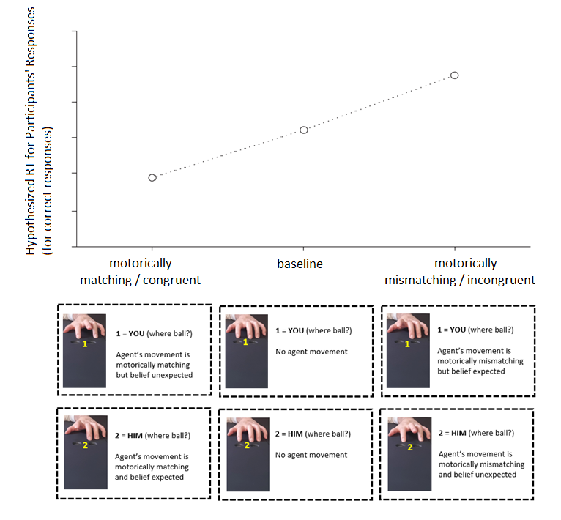
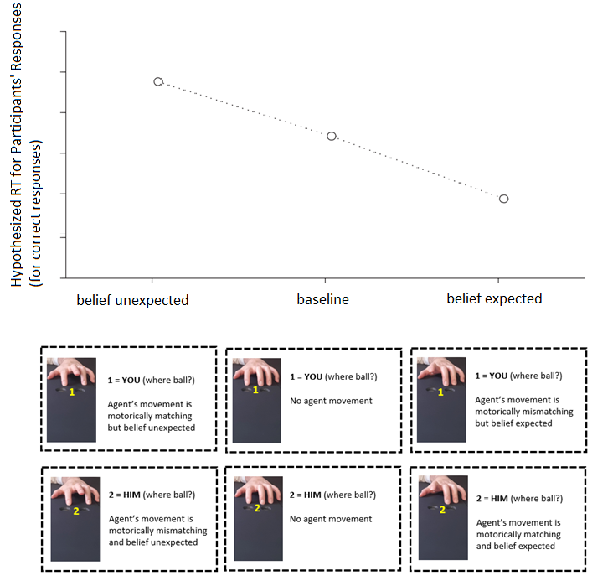

Slide 3
1 = Where do YOU think the ball is located?
If at index finger location, lift index finger.
If at middle finger location, lift middle finger.
2 = Where does HE think the ball is located?
If at index finger location, lift index finger.
If at middle finger location, lift middle finger.
Agent makes no movement (baseline)
1 = YOU (where ball?)
No observed movement
2 = HIM (where ball?)
No observed movement
1
2
ball changes location whilst agent is away, resulting in agent having location false-belief
Agent’s movement matches action that participant is required to execute
1 = YOU (where ball?)
Observed movement is motorically matching but belief unexpected
2 = HIM (where ball?)
Observed movement is motorically matching and belief expected
1
2
Trial sequence with one of six ending scenes
Agent’s movement mismatches action that participant is required to execute
1 = YOU (where ball?)
Observed movement is motorically mismatching but belief expected
2 = HIM (where ball?)
Observed movement is motor mismatching and belief unexpected
1
2

Slide 4
Agent makes no movement (baseline)
1 = YOU (where ball?)
No observed movement
2 = HIM (where ball?)
No observed movement
1
2
Agent’s movement matches action that participant is required to execute
1 = YOU (where ball?)
Observed movement is motorically matching but belief unexpected
2 = HIM (where ball?)
Observed movement is motorically matching and belief expected
Trial sequence with one of six ending scenes
1
2
Agent’s movement mismatches action that participant is required to execute
1 = YOU (where ball?)
Observed movement is motorically mismatching but belief expected
2 = HIM (where ball?)
Observed movement is motor mismatching and belief unexpected
1
2

